Slide 1


Unveiling Airbnb: Exploring Global Operations and Insights
“Unlocking Insights: Airbnb's Global Impact through Data-driven Analysis from iVision”

Slide 2





Title: "Key Objectives"
1
Review Score Analysis
Host Experience Analysis
Property wise Analysis
Trends and Patterns Analysis
Summary and Recommendations
2
3
4
5

Slide 3

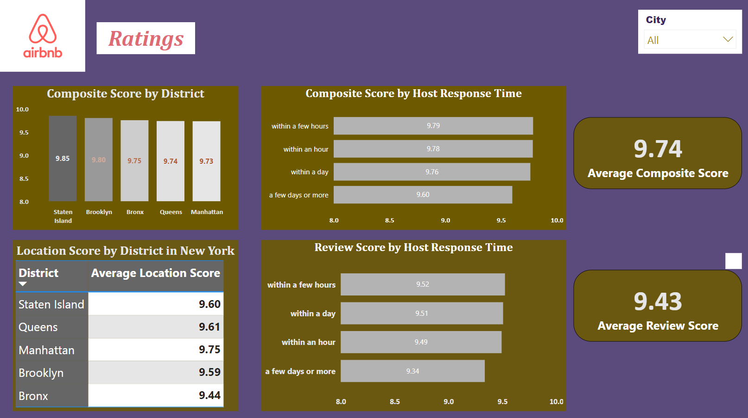
Review Score Analysis
Insights:
Staten Island emerges as the top-performing district in both location and composite scores, indicating high satisfaction among guests.
Manhattan, despite being a popular tourist destination, lags behind in both location and composite scores, suggesting potential areas for improvement.
The importance of timely host response times is highlighted, with ratings significantly higher for responses within a few hours compared to longer response times.
Recommendations:
Focus efforts on improving location amenities and experiences in Manhattan to enhance guest satisfaction.
Implement strategies to encourage prompt host response times, such as automated messaging systems or incentives for quick responses.

Slide 4

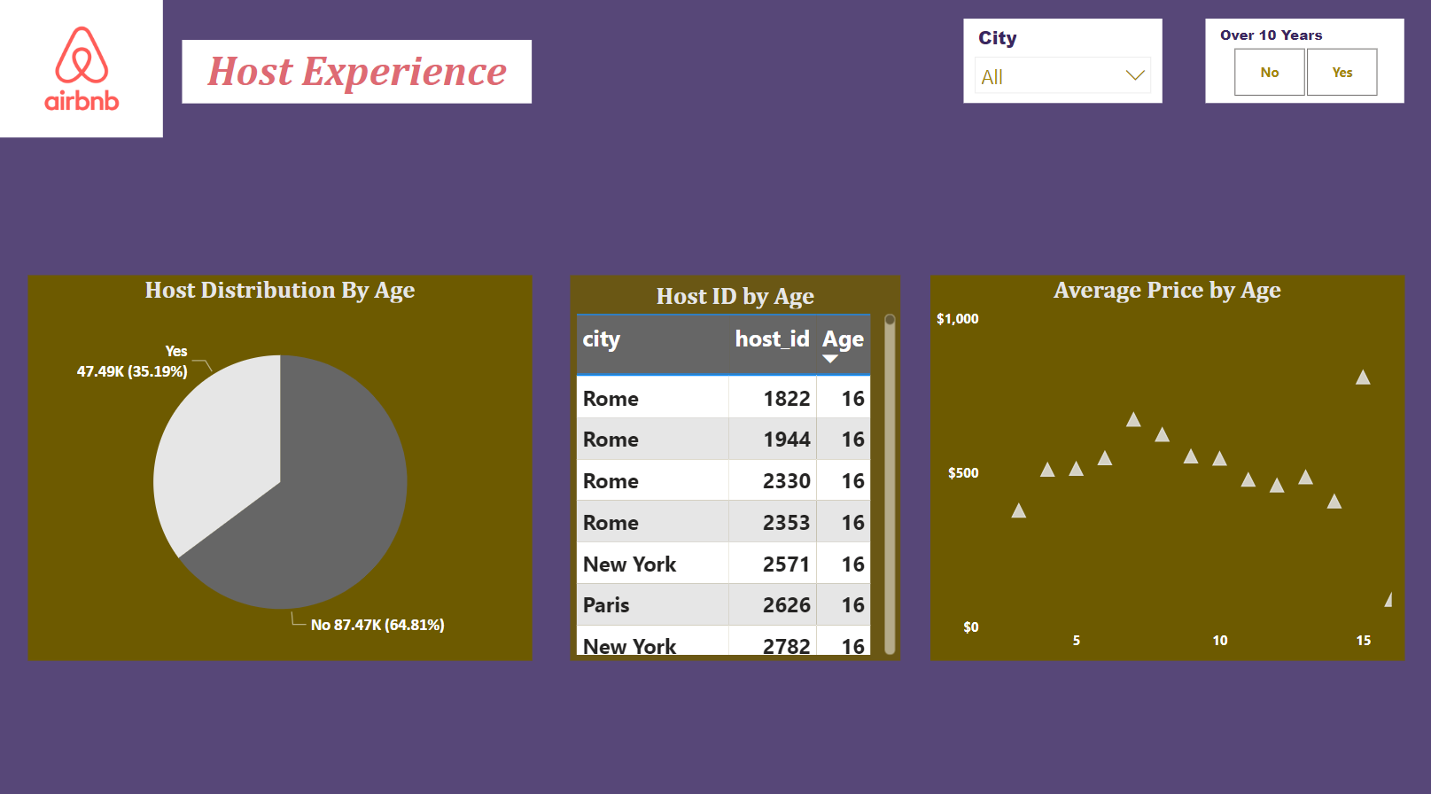
Host Experience Analysis
Insights:
The majority of hosts on the platform have less than 10 years of experience, indicating a relatively newer cohort dominating the hosting community.
Host tenure plays a significant role in pricing dynamics, with average prices generally increasing with tenure up to a certain point before plateauing or declining.
Recommendations:
Explore strategies to support and retain experienced hosts, as they may contribute to higher guest satisfaction and potentially higher earnings.
Analyze pricing strategies and market trends to optimize pricing strategies for hosts at different tenure levels.

Slide 5

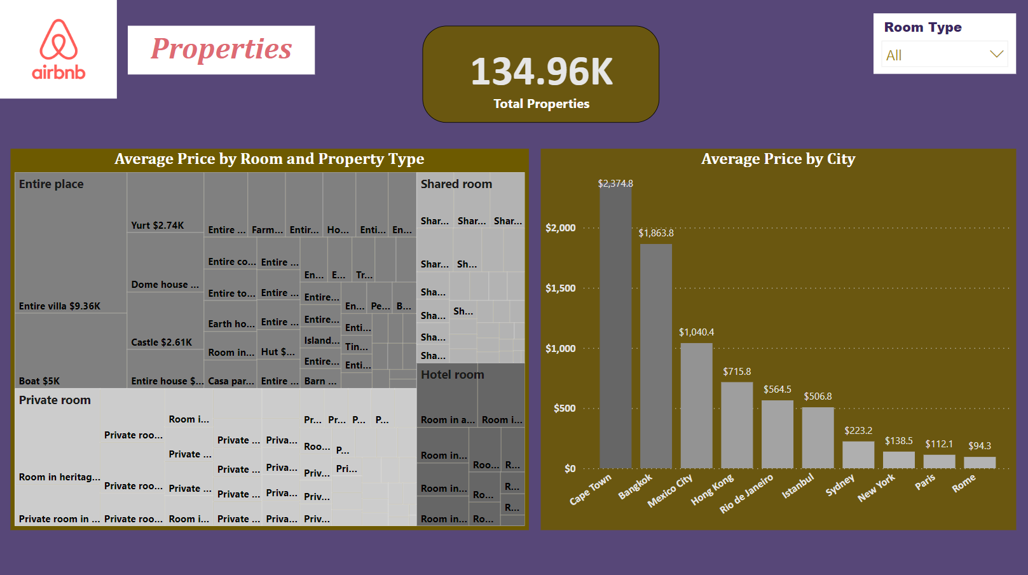
Property wise Analysis
Insights:
Accommodation type significantly influences pricing, with entire places generally commanding higher prices compared to private rooms, shared rooms, and hostel rooms.
Cape Town emerges as the top-priced destination among the selected cities, indicating strong demand and potentially lucrative opportunities for hosts in that market.
Recommendations:
Hosts can capitalize on pricing differentials by strategically listing entire places or private rooms to maximize earnings.
Further exploration of pricing dynamics in top-performing cities like Cape Town can uncover insights into demand drivers and competitive positioning.

Slide 6

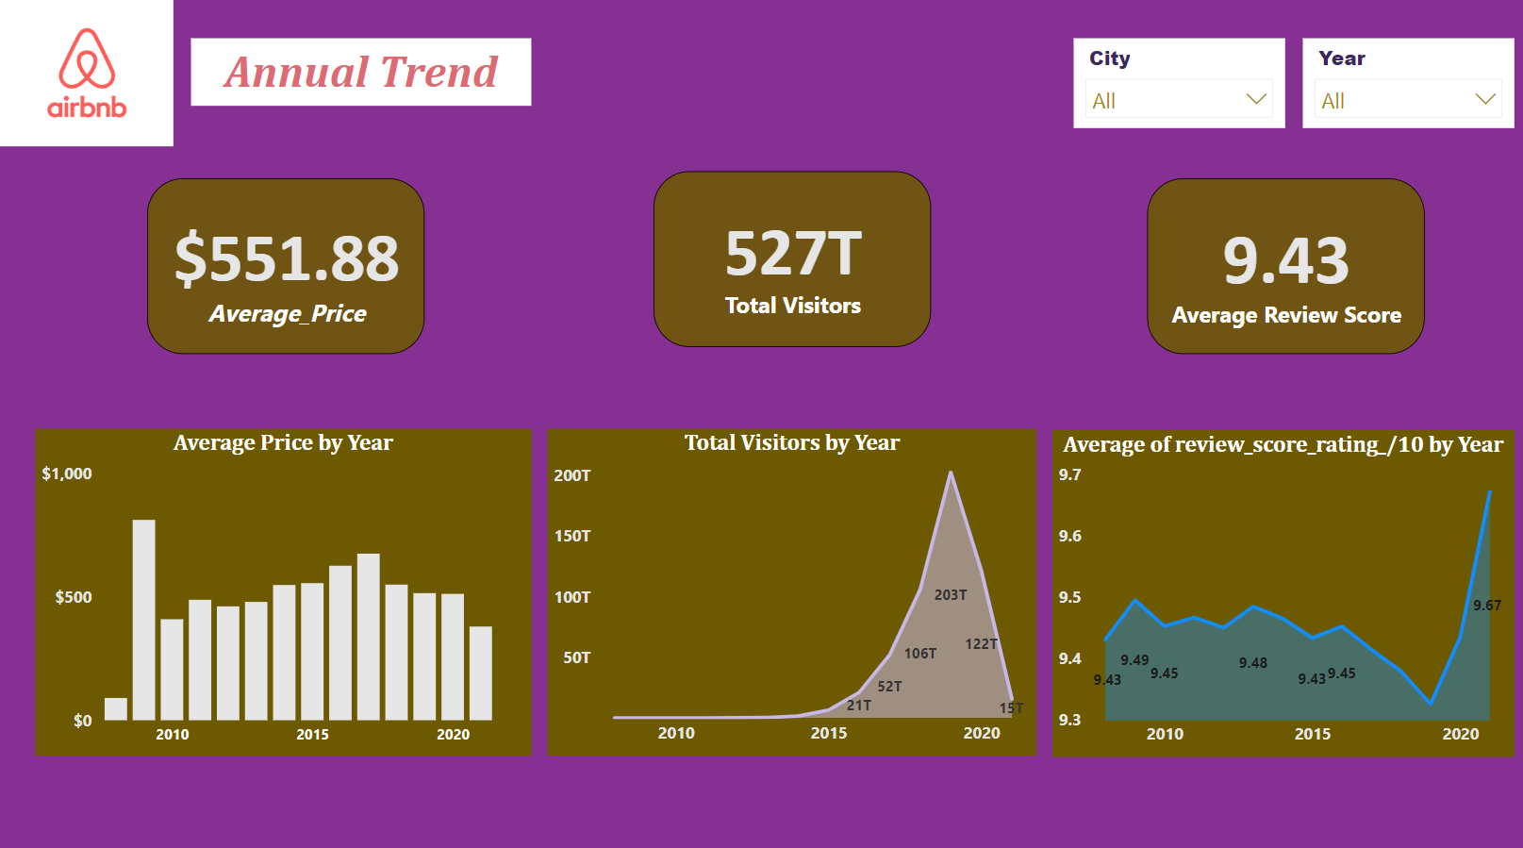
Trends and Patterns Analysis
Insights:
The decline in average prices post-2016 and the subsequent dip in 2020 can be attributed to various factors, including market saturation, regulatory changes, and the COVID-19 pandemic's impact on travel.
Seasonal fluctuations in visitor numbers highlight the importance of aligning pricing and marketing strategies with peak periods to maximize revenue.
The recent spike in average review scores post-2020 suggests an improvement in guest satisfaction, possibly driven by enhanced safety measures and service offerings in response to the pandemic.
Recommendations:
Continuously monitor market trends and adjust pricing strategies accordingly to remain competitive and responsive to changing demand dynamics.
Leverage seasonal peaks in visitor traffic by offering targeted promotions and packages to attract more guests during high-demand periods.
Maintain a focus on delivering exceptional guest experiences to sustain positive review scores and drive repeat bookings and referrals.

Slide 7
Empowering AirBnB for Success
Summary of Key Insights:
District Location Score Variations: The analysis reveals significant variations in location scores across different districts in New York. Staten Island emerges as the district with the highest rating, while Manhattan lags behind with the lowest score. This suggests that guests perceive certain districts more favorably than others, potentially due to factors such as accessibility, amenities, and overall appeal.
Room Type and Property Type Influence on Prices: The tree diagram highlights the influence of room type and property type on pricing. Entire places command the highest prices, followed by private rooms, shared rooms, and hostel rooms. This indicates that accommodation type significantly impacts pricing strategies, with hosts able to leverage different property types to maximize earnings.
Top Cities by Average Price: The bar chart identifies Cape Town as the city with the highest average price among the top 10 cities analyzed. This suggests strong demand and potentially higher revenue opportunities for hosts in Cape Town compared to other destinations. Understanding pricing dynamics in top-performing cities can inform strategic decisions for hosts and property managers.
Host Response Time and Communication: Analysis of host response time reveals a clear correlation between timely responses and higher review scores. Guests value quick and effective communication, as evidenced by the higher ratings for hosts who respond within a few hours compared to those with longer response times. Hosts should prioritize prompt responses to guest inquiries and messages to enhance the guest experience and drive positive reviews.
Impact of External Factors on Review Scores: The fluctuation in average review scores over time highlights the influence of external factors such as market trends, regulatory changes, and global events. After a period of stagnation and decline, review scores spiked again after 2020, possibly indicating improved guest satisfaction due to enhanced safety measures and service offerings in response to the COVID-19 pandemic.
Cont.

Slide 8
Empowering AirBnB for Success
Recommendations for Strategic Improvements:
District-level Targeting: Hosts and property managers can capitalize on district-level variations in location scores by focusing marketing efforts and investment in districts with higher ratings. Enhancing amenities, promoting local attractions, and improving accessibility can further elevate district appeal and guest satisfaction.
Strategic Pricing Strategies: Hosts should strategically adjust pricing based on room type and property type to maximize revenue. Offering competitive rates for high-demand accommodation types while leveraging premium pricing for unique or luxury properties can optimize earnings and attract guests seeking diverse accommodation options.
Market Expansion Opportunities: Consideration should be given to expanding operations in cities with higher average prices, such as Cape Town, to capitalize on revenue opportunities and diversify market presence. Targeted marketing campaigns and partnerships can help penetrate new markets and attract high-value guests seeking premium accommodation experiences.
Investment in Communication Infrastructure: Hosts and property managers should invest in communication infrastructure and technologies to facilitate prompt and effective responses to guest inquiries and messages. Implementing automated messaging systems, training staff on effective communication practices, and monitoring response times can enhance guest satisfaction and drive positive reviews.
Adaptation to Changing Market Dynamics: Continuous monitoring of market trends and guest feedback is essential for adapting to changing market dynamics and guest preferences. Hosts should remain agile and responsive to emerging trends, regulatory changes, and external events to maintain competitiveness and sustain long-term success in the Airbnb ecosystem.

Slide 9


